Slide 1
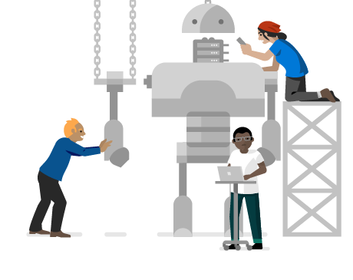
Microsoft Certified Professionals
1st Community Meetup

Slide 2

Agenda
Welcome to MCP | GR CY MT Community
Community Scope, Activities and Plan
Welcome to Cloud Expert Community - Microsoft GR CY MT
Albertos Bourlas – Microsoft Hellas
Meet our Experts
Azure Infrastructure – Pantelis Apostolidis (Microsoft Hellas)
Azure Serverless – Vaggelis Kappas (Microsoft Hellas)
Azure Data Platform – Vassilis Ioannidis (MCT-Cloud Architect)
Azure DevOps – Dimitris Pantazis (MCT-Cloud Architect)
Azure Application Development – Vasilis Salis (Microsoft Hellas)
Azure AI – George Armeniakos (Microsoft Hellas)
Microsoft 365 – Sophie Chanialaki (Microsoft Hellas)
Microsoft Security – Michael Haggar (Microsoft Hellas)
4.What's next
Contests and Tools – Ioannis Stavrinides (Microsoft Hellas)

Slide 3

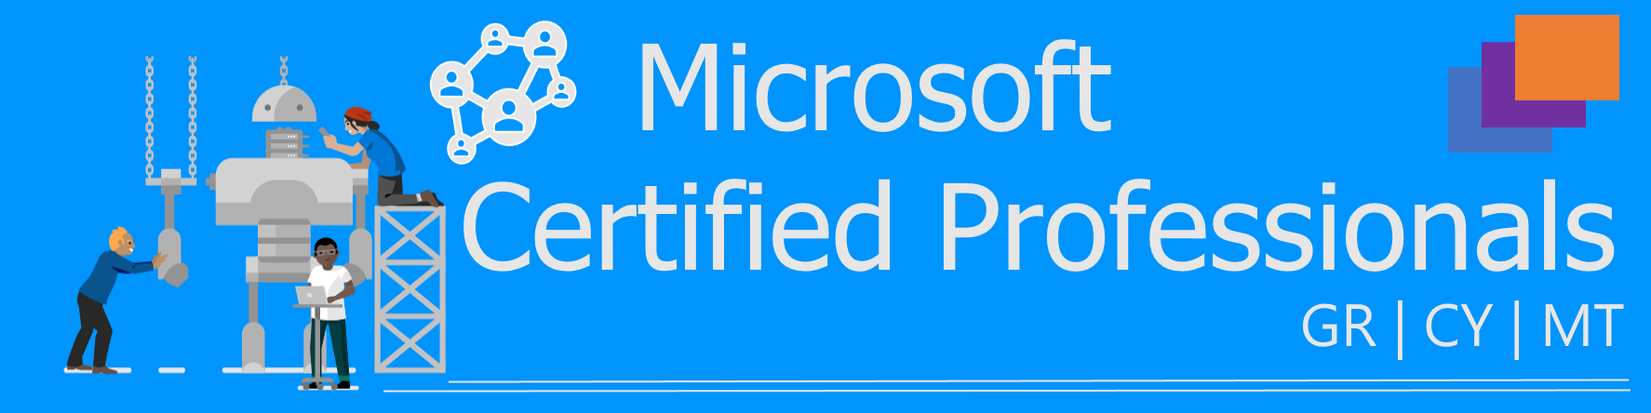

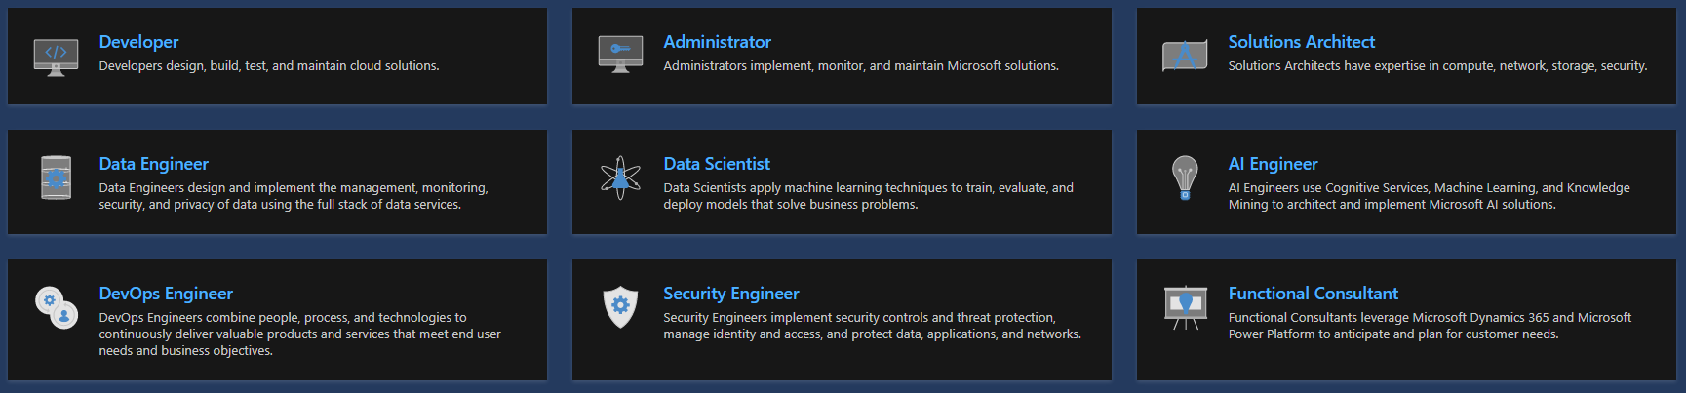
Welcome
We Are 500+
https://www.linkedin.com/groups/8981254/

Slide 4
Plan and Activities
Sept 20
Oct 20
Nov 20
Dec 20
Jan 21
Feb21
Mar 21
Jul 21
Dec 21
Community Announcement
Microsoft Certified Trainers Continuous Collaboration
ITPRO DEV
Cloud Services Poll
1st MVP
Meet Up
2nd MVP Meet Up
1st Meetup
Welcome
2nd Meetup
1st HOL
3rd Meetup
Meetups…
Azure Part
Azure Part
Azure Part
Azure Part…
Data Part
Azure Part
Data Part
Data Part…
Dev Part
Dev Part
Dev Part
Sec Part
Sec Part
Sec Part
Dev Part…
O365 Part
O365 Part
O365 Part
Sec Part…
Exam Prep
Exam Prep
Exam Prep
O365 Part…
1st Contest
Career Days…
1st Career Days
Contest…
2nd Contest
3rd MVP
Meet Up
1st Event

Slide 5


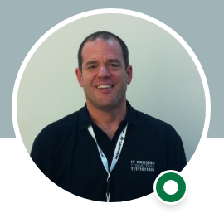




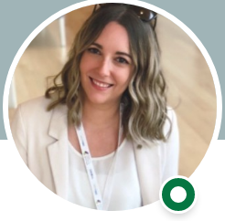


Meet the experts
Albertos Bourlas
Microsoft Hellas
Pantelis Apostolidis
Microsoft Hellas
Vaggelis Kappas
Microsoft Hellas
Vassilis Ioannidis
MCT | Cloud Architect
Dimitris Pantazis
MCT | Cloud Architect
Vassilis Salis
Microsoft Hellas
Sophie Chanialaki
Microsoft Hellas
George Armeniakos
Microsoft Hellas
Ioannis Stavrinides
Microsoft Hellas
Michael Haggar
Microsoft Hellas

Slide 6






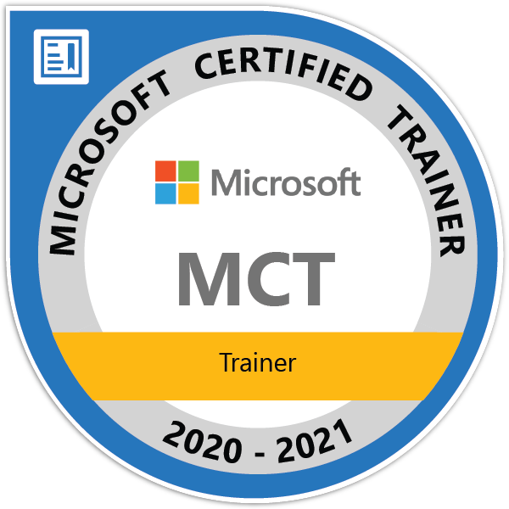
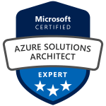


Azure Data platform
A few bits about me
“
Been working in production workloads with SQL Server since version 7
SQL Server performance tweaking-geek
Love to work with Azure and data
Long-life learner
https://sqltattoo.com
@sqltattoo
/in/vassilis-ioannidis
me@sqltattoo.com
github.com/SQLtattoo
Vassilis Ioannidis
Consultant | Trainer | Speaker
Cloud Solutions Architect
@ incadea
Since 2005
Since 2000

Slide 7




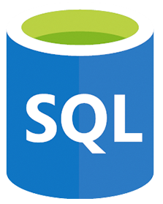




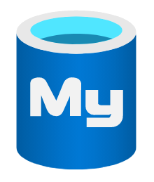



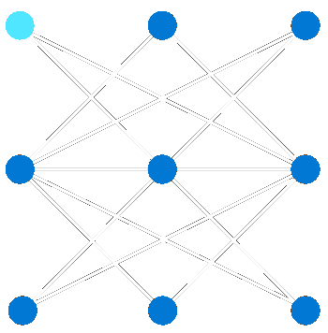



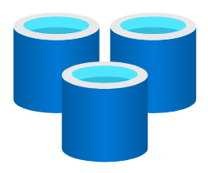
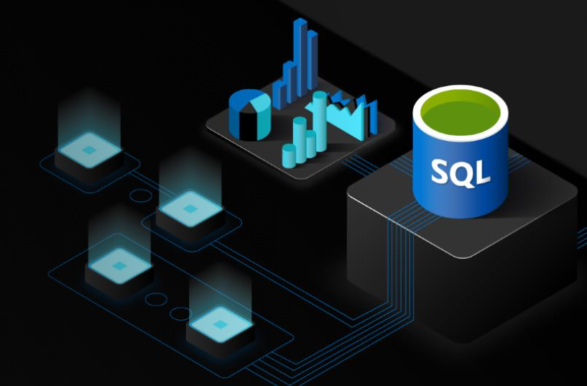
Azure Data platform
The power of choice
Broaden your horizons
Relational and NoSQL
Analytics
App modernization
Intelligent insights
Managed & IaaS SQL databases
Azure Synapse
Power BI
Data Factory
Open-source SQL databases
Data Bricks
Machine Learning
Data Lake Storage
Smart Security
AI and machine learning
NoSQL databases
Open-source in-memory
Guidance to help you choose the best database for your use case and requirements https://azure.microsoft.com/en-us/product-categories/databases/

Slide 8

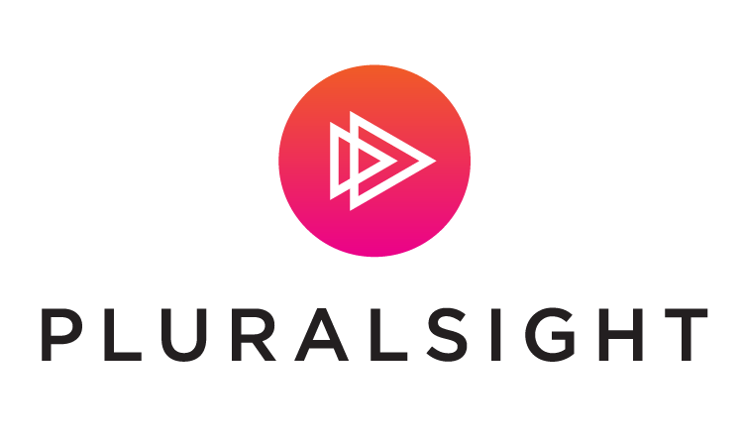
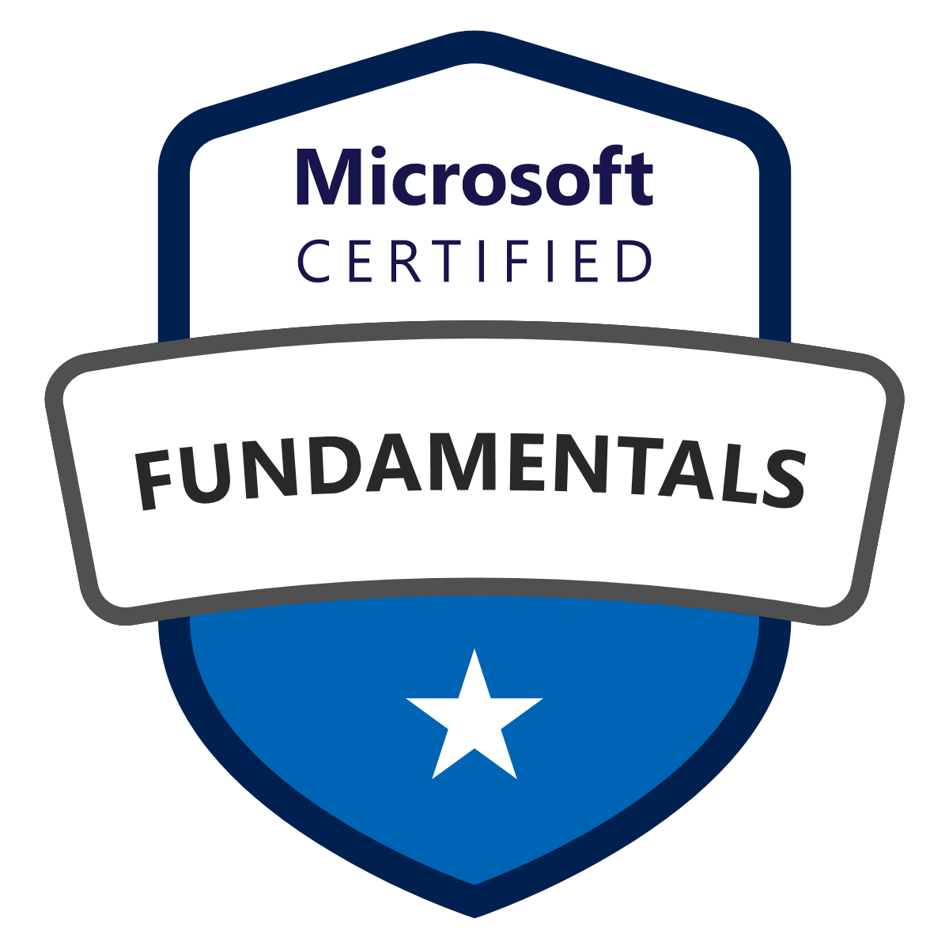
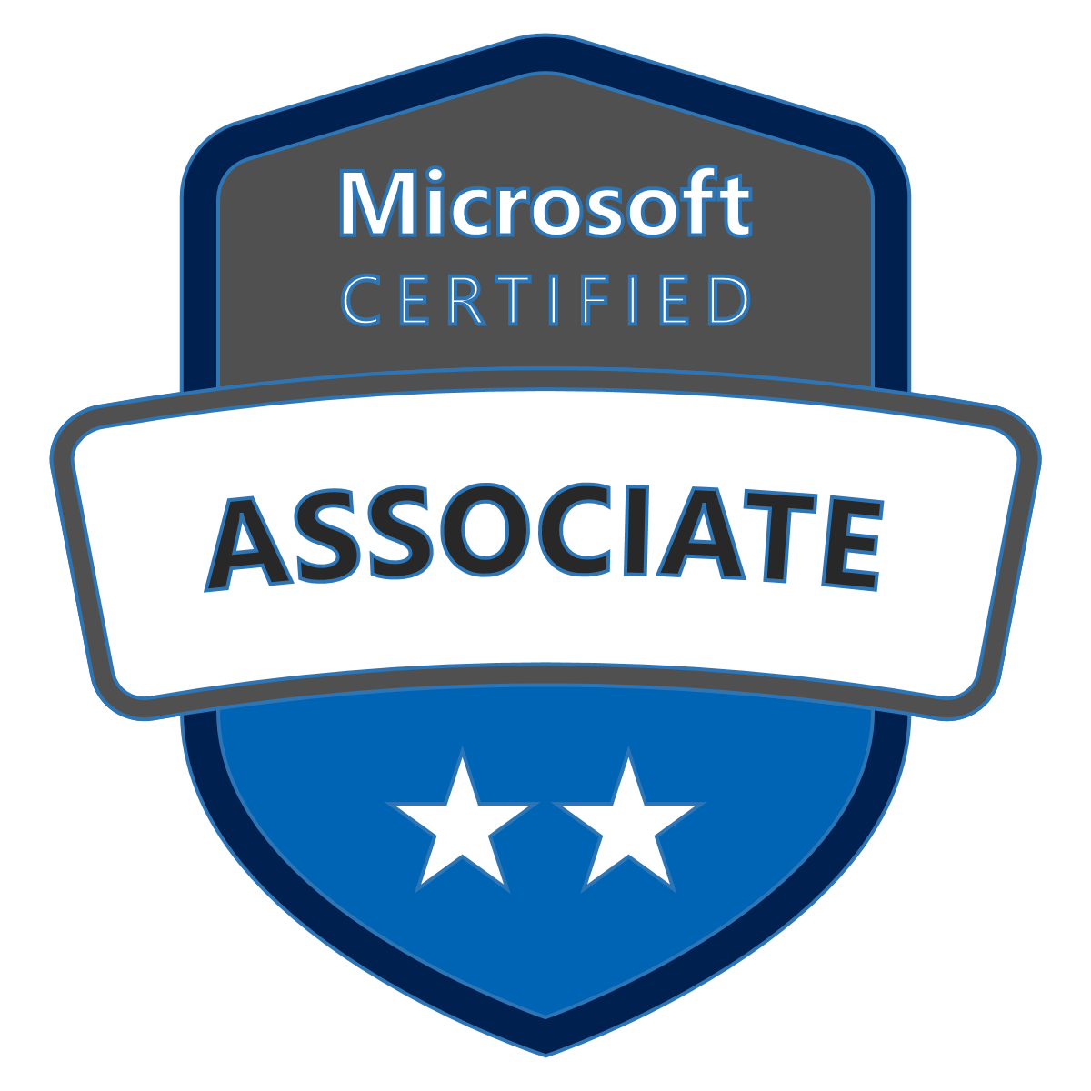
Azure Data platform
docs.microsoft.com
Skill up – Learning & Certification for Azure Data Platform
Job roles: Data Engineer, Database Administrator, Data Scientist, AI Engineer
Microsoft Certified: Azure Database Administrator Associate
docs.microsoft.com/en-us/learn/certifications/azure-database-administrator-associate
DP-900 Azure Data Fundamentals
Microsoft Certified: Azure Data Fundamentals
DP-300
Administering Relational Databases
on Microsoft Azure
Microsoft Certified: Azure Data Engineer Associate
docs.microsoft.com/en-us/learn/certifications/azure-data-engineer
DP-200 Implementing an
Azure Data Solution
DP-201
Designing an
Azure Data Solution
Microsoft Certified: Azure Data Scientist Associate
docs.microsoft.com/en-us/learn/certifications/azure-data-scientist
AZ-900 Microsoft Azure Fundamentals
Microsoft Certified: Azure Fundamentals
DP-100 Azure Data Scientist
Microsoft Certified: Azure AI Engineer Associate
docs.microsoft.com/en-us/learn/certifications/azure-ai-engineer
AI-900
Azure AI
Fundamentals
Microsoft Certified: Azure AI Fundamentals
AI-100
Azure AI Engineer

Slide 9

Azure Data platform
Azure SQL Resources
Microsoft Learn: Azure SQL fundamentals learning path
aka.ms/azuresqlfundamentals
Select the Azure SQL Workshop
aka.ms/sqlworkshops
How to choose tool
aka.ms/chooseazuresql
Azure SQL documentation
aka.ms/azuresqldocs
More videos from the SQL team
aka.ms/azuresql4beginners
aka.ms/dataexposed

Slide 10

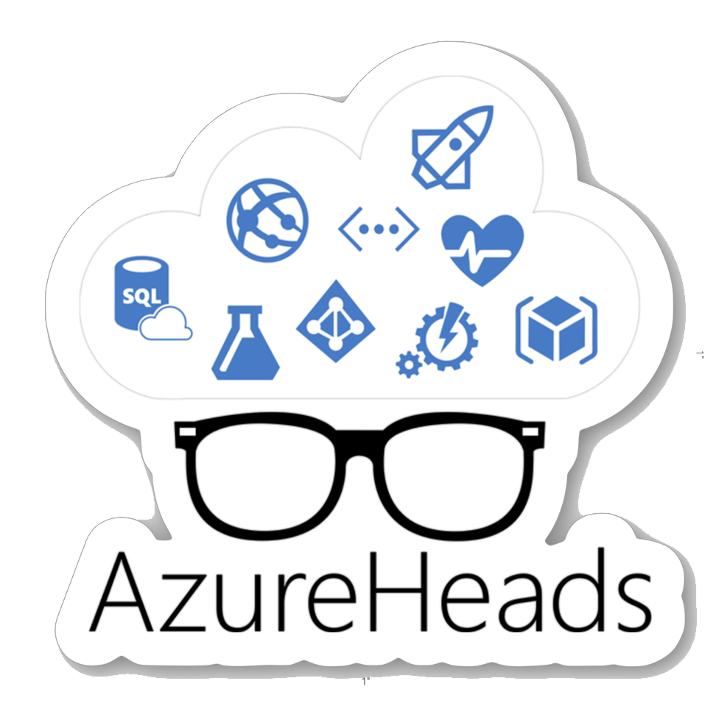
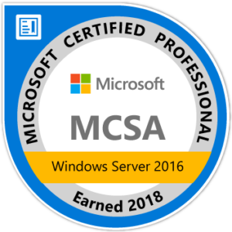
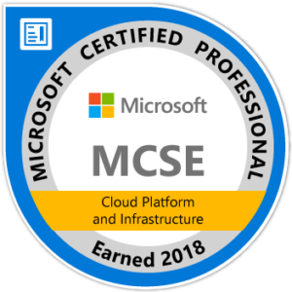
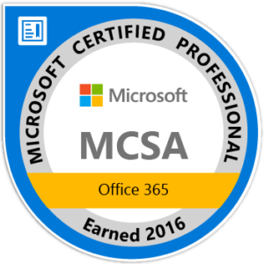


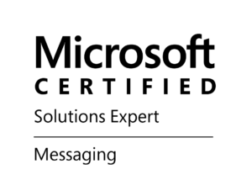
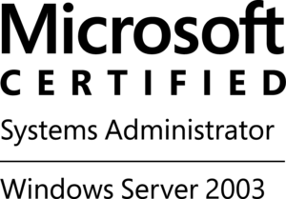
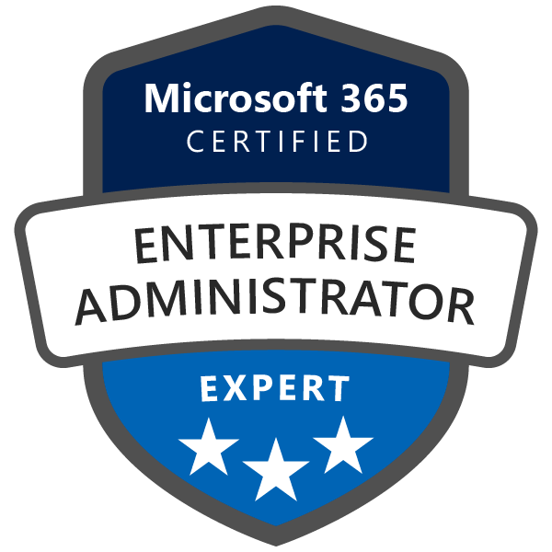
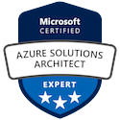
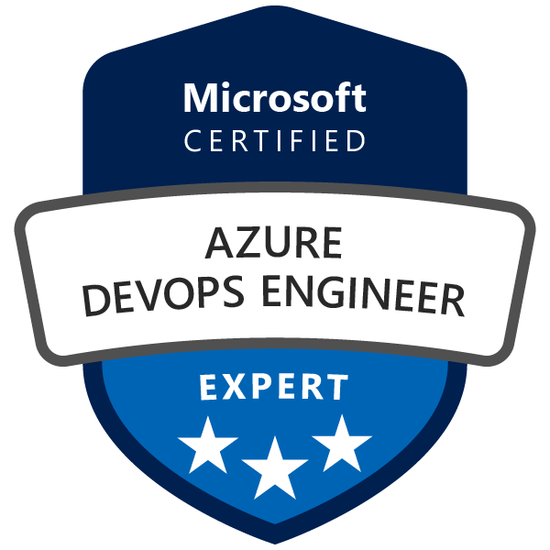
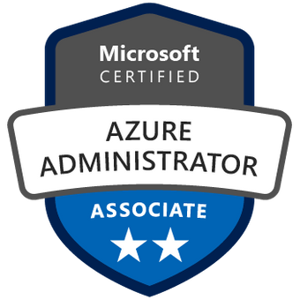


Azure INFRRASTRUCTURE (iaas)
A few bits about me
“
I love helping people & companies to adopt and deploy cloud technologies
Live long & learn!
https://e-apostolidis.gr
@papostolidis
/in/papostolidis
Pantelis.Apostolidis@microsoft.com
github.com/proximagr
Pantelis Apostolidis
author, blogger, public speaker, azure ninja
Cloud Solution Architect
@ Microsoft
Since 2002

Slide 11

Azure infrastructure as a service (IaaS)
Virtual Machines
Windows Server and Linux Virtual Machines
Choose from Microsoft images or images provided by partners and the community
Enhance security and compliance
Scale to what you need
Pay only for what you use

Slide 12

Azure infrastructure as a service (IaaS)
Storage
Highly scalable, durable, available storage system
Blobs can be exposed over http (JSON + CORS)
Optionally enable client apps short term access
Import / Export Service with Physical Drives

Slide 13

Azure infrastructure as a service (IaaS)
Virtual Network
Enhance security and isolation
Build sophisticated network topologies
Extend your datacenter into the cloud

Slide 14

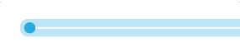

Load Balancing and High Availability
Availability Set
Availability Zone
Load-Balanced Traffic (TCP/UDP)

Slide 15
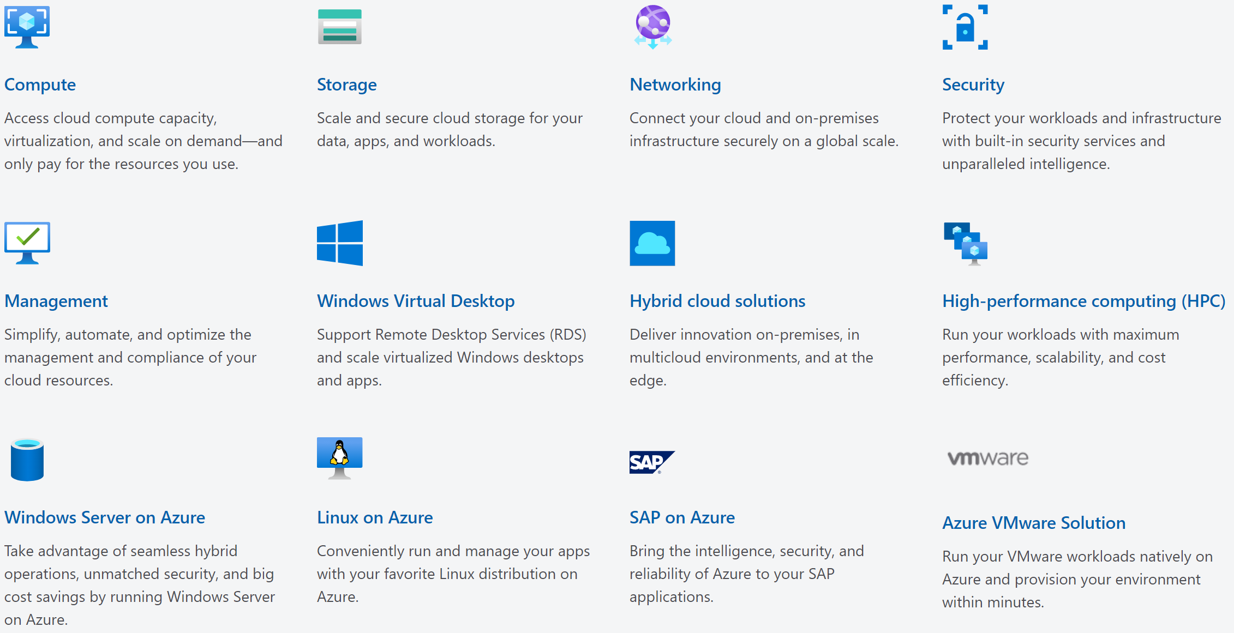
Azure infrastructure as a service (IaaS)
Guidance to help you choose the best database for your use case and requirements: https://azure.microsoft.com/en-us/overview/what-is-azure/iaas/

Slide 16


Azure infrastructure certifications
Skill up – Learning & Certification for Azure Infrastructure
Job roles: Cloud Security Engineer, Azure Administrator, Cloud Solution Architect
Microsoft Certified: Azure Solutions Architect Expert
Microsoft learn
AZ-303
Microsoft Azure Architect Technologies
AZ-304
Microsoft Azure Architect Design
Microsoft Certified: Azure Administrator Associate
docs.microsoft.com
ΑΖ-104 Microsoft Azure Administrator
AZ-900 Microsoft Azure Fundamentals
Microsoft Certified: Azure for SAP Workloads Specialty
Microsoft Certified: Azure Fundamentals
AZ-120
Planning and Administering Microsoft Azure for SAP Workloads
Microsoft Certified: Azure Security Engineer Associate
AZ-500
Microsoft Azure Security Technologies
https://docs.microsoft.com/en-us/learn/certifications/

Slide 17
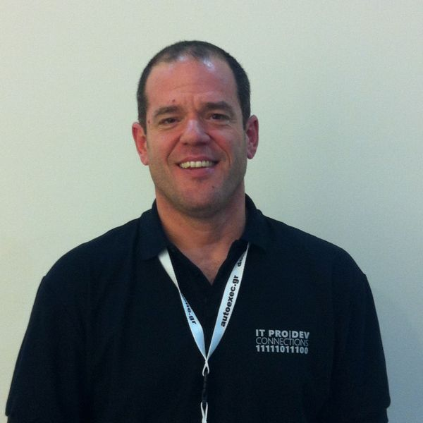
Azure Serverless
A few bits about me
“
“
Intellectually curious and enthusiastic about anything new and innovative.
https://vaggeliskappas.gr
@vaggeliskappas
/in/vkappas
vakappas@microsoft.com
github.com/vakappas
Vaggelis Kappas
Azure Infrastrucure Specialist
Microsoft

Slide 18
The “evolution” of application platforms
On-Premises
IaaS
PaaS
Serverless

Slide 19
Before cloud
What is the right size of
servers for my business needs?
How do I deploy new code to my server?
What media should I
use to keep backup?
What happens in case of
server hardware failure?
Which packages should be on my server?
What size of servers
should I buy?
Who monitors
my App?
How often should I backup my server?
How can I scale my app?
How can I increase server utilization?
Who has physical
access to my servers?
Which OS should I use?
Do I need secondary network connection?
Are my server in a
secure location?
What happens if the
power goes out?
Who monitors
my Servers?
Do I need a UPS?
What storage I need to use?
How many servers
do I need?
How can I dynamically configure my app?
It takes how long to provision a new server?
How often should
I patch my servers?
Notes:
Talking points: (New)
Note to speaker: no extra clicks needed, all visuals will fly in on their own at page load time.
Before Cloud (or even now), let’s say you run a successful business and you try to build business apps, you have two options. You can either build on premises or co-location. You will go and buy servers and infrastructure to run your business applications.
With that came many questions when you build and manage your own server. From what servers to buy, how to provision my new server, what do I do if there is hardware failure, to how to deploy my code and patch my servers, there are simply too many things to consider.
It can be overwhelming when you manage your own physical servers.

Slide 20
Then came IaaS
What is the right size of servers for my business needs?
What is the right size of servers for my business needs?
How can I increase server utilization?
How can I increase server utilization?
How many servers do I need?
How many servers do I need?
How can I scale my app?
How can I scale my app?
How often should I patch my servers?
How do I deploy new code to my server?
How do I deploy new code to my server?
How often should I backup my server?
Which OS should I use?
Which OS should I use?
Which packages should be on my server?
Who monitors my App?
Who monitors my App?
Notes:
points: (New)
Note to speaker: no extra clicks needed
Well, a much cleaner picture, isn’t it? A few years later, there is this thing called “IaaS”. The idea is, you don’t need to buy or build your own servers, use our infrastructure service, aka IaaS.
With that, you don’t have to worry about provisioning your servers, or securing the physical location of your server farm. Many questions go away.
But, there is but… you still need to think about which IOS to use, how to patch the server, in addition to managing your business apps. Can those tedious tasks be taken care of as well?

Slide 21
Then PaaS, critical for digital transformation
What is the right size of “servers” for my business needs?
How can I increase “server” utilization?
How many “servers” do I need?
How can I scale my app?
Notes:
Talking points: (New)
Yes. We have this service called Platform as a Service, PaaS. What is great about it is, VM patching, IOS selection, back up and code deployment are all built into PaaS platform for you. Isn’t that great?
Now only four questions remain,
How many servers do I need?
What is the right size of server for my biz? S1, P3?
How can I increase server utilization?
More importantly, how I scale my app?
Let’s see how everything works together so far --- transition into the IaaS & PaaS chart.

Slide 22
Serverless, the future platform for next gen apps
How do I architect my app to become Serverless?
Notes:
Talking points: (New)
What do we go from here?
Introducing Serverless, an event-driven process, which will grow and scale on demand.
The only remaining question now becomes: How I architect my app to become Serverless? Pretty neat, right?
It all sounds great, naturally, you may ask, how does Serverless fit into the picture?

Slide 23
What is Serverless?
Abstraction of servers
Event-driven/ instant scale
Micro-billing
Notes:
Abstraction of servers, infrastructure and configuration of operating system
Event-driven scale
Sub-second billing
Stateless
Serverless compute is a fully managed service. Some refer to it as Functions as a Service
OS and Framework patching is performed for you
There is zero administrative tasks and no need to manage any infrastructure
You just deploy your code (function) and it runs
Your code runs within seconds and for very short period of time
Serverless compute scales quickly (almost instantly) and vastly
Automatically scales within seconds
No scale configuration is required (there is no way to configure scale or limits)
Scales to match any given workload. Scales from zero to handle tens of thousands concurrent functions invocations within seconds
Pay only for the time your code is running
Serverless compute reacts to events
React, in near real-time, to events and triggers
Triggered by virtually any event from Azure service or 3rd party services

Slide 24
Benefits of Serverless
Manage apps not servers
Reduced DevOps
Faster time to market
Notes:
“Pinnacle of PaaS compute”
Not just hardware “servers”, but software servers are also managed for you
Focus on business logic, not solving technical problems not core to business
Lower effort to get started makes it easier to experiment (bots, etc.)
Benefits of “Serverless”

Slide 25




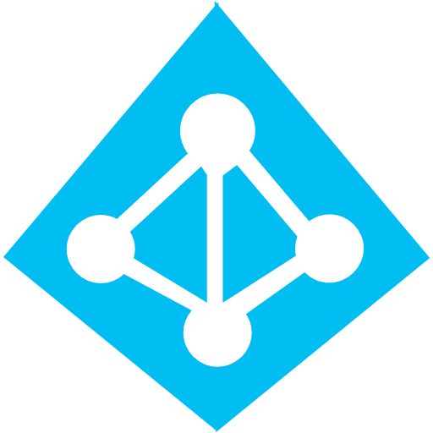



Serverless application platform components
Development
Platform
IDE support
Functions
Logic apps
Event Grid
Integrated DevOps
Developer productivity
Visual designer
Manage all events in one place
Triggers and Bindings
100+ connectors
Near real-time delivery
Local development
Flexible deployment options
Functions orchestration
Broad coverage
Monitoring
Database
Storage
Security & Access Control
IoT
Analytics
Intelligence
Visual Debug History
Notes:
Lets talk about what really makes up MSFT’s Serverless platform: At the center of the Serverless platform, is our compute offerings: Azure Functions and Azure Logic Apps. Azure Functions is an event based Serverless compute experience that helps you accelerate your development. Logic Apps is a powerful orchestration tool. It enables building a Serverless app in minutes – by orchestrating multiple functions using a visual workflow tool.
Say you have your apps up and running using Serverless. Congratulations! You now need to collect intelligence from different apps across platforms to take actions upon. There are a few essential components which we think are core to building Serverless applications are:
Data/ Storage –Functions has triggers and bindings with Azure document DB and Azure Blob storage
** Triggers: Triggers are event responses used to trigger your custom code. They allow you to respond to events across the Azure platform or on premise.
** Bindings: Bindings represent the necessary meta data used to connect your code to the desired trigger or associated input or output data.
Messaging such as queues and topics using Azure Service Bus and Azure Event Hubs
Integration – that includes core LOB apps and SaaS apps integration via Azure Logic Apps.
Intelligence on data and sentiment/ predictive analysis using Cognitive services and Machine learning
Conversation as a service – how do we equip developers to build apps that offer an end-to-end experience for their end users – Azure Bot Service offers a Serverless interactive bot experience.
More, developers are spending more time writing code that allows them to add huge business impact with Serverless. MSFT offers numerous development tools such as IDE Support for Visual Studio in functions and Logic Apps, enables local development (vs web browser coding environment), visual debugging capability, all with your tools of choice.
Lastly, I also want to highlight top scenarios and use cases for Serverless:
Real-time Stream analytics: Customers can use Functions to feed real-time streams of data from application tracking into structured data and store it in SQL online.
SaaS event processing: Customers can use Functions and Logic Apps to analyze data from an excel file in Onedrive and perform validation, filtration, sorting and convert data into consumable business charts
Web app architecture: Used a lot in creating targeted marketing collaterals – when a customer clicks on a webpage, it triggers a webhook, that uses a function to create an ad that matches the customer profile and displays a completed webpage.
Real-time bot messaging: When customers send a message to a chatbox, Functions calls Cortana analytics to generate appropriate answers and sends a response back.
//from before: Customers have different paths to build a Serverless app – start by building the distributed application components using functions by leveraging the numerous templates and declarative bindings Or
Start with the workflow and orchestration of Serverless application using Azure Logic Apps. The visual designer enables developers to quickly and easily author, edit and visualize orchestration of multiple functions and workflow.

Slide 26
Scenarios
Anything that needs to respond to events
Real-time stream processing
Timer-based processing
Millions of devices feed into Stream Analytics
Transform to structured data
Store data in SQL DB
Every 15 minutes
Find and clean invalid data
Clean table
Mobile app backends
Real-time bot messaging
?
...
Photo taken and WebHook called
Stores in blob storage
Produces scaled images
Message sent to Chatbot
Chatbot sends
response
Cortana Analytics answers questions
Notes:
So what kind of apps and scenarios can be built using serverless technologies?
The answer is anything where there is need to run some logic in response to an event.
Some of you might be surprised to learn that, the above definition covers a big portion of the computing universe. Modern computing is all about events:
An IoT device sending data to analyze and store in real-time is an event. There are billions of those. Handling of such data such as enriching, analyzing or filtering is best done using serverless functions which can be spun up on demand.
Almost every web based application needs to run some regular maintenance task like cleaning up a database or synchronizing data between two systems. All of these times are events. Such tasks that need to be run only at specific times, don’t call for dedicated infrastructure. They are best left to serverless solutions.
A mobile app clicking a picture and submitting to backend is an event. There are billions of such apps. In many cases developers building such apps want to focus on delighting their customers using clients app experience. Serverless technology can easily take away the burden of building mobile backends.
Automated response systems receiving a customer request is an event. Building intelligent bots for such scenarios using serverless technology is again a great example where the focus needs to be on logic instead of infrastructure.
These are only some of the many examples which fit well with serverless.

Slide 27

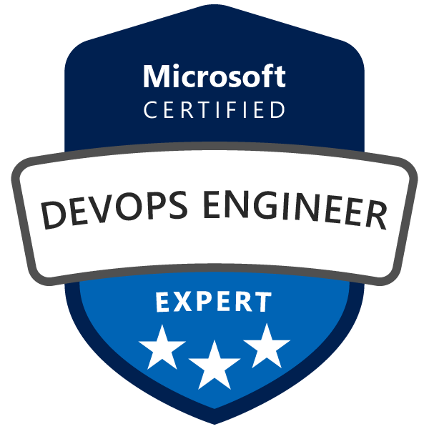
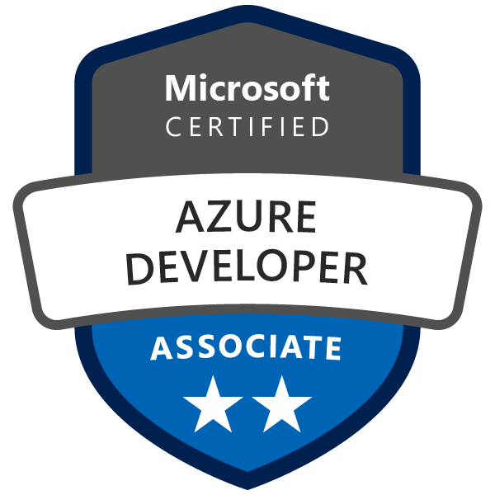
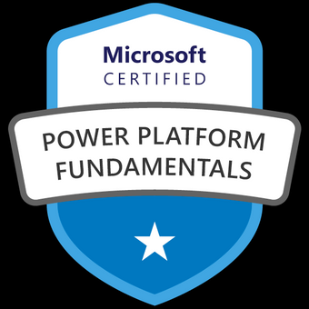
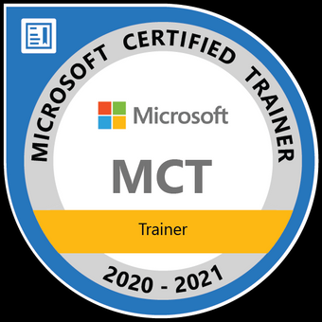

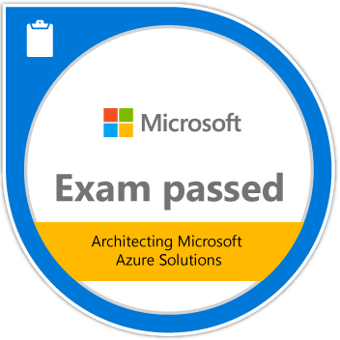
Azure Application Development
A few bits about me
“
Working with ISV partners on designing, developing, building, porting, optimizing, …,
awesome solutions to Azure
/in/vasalis
github.com/vasalis
vasalis@microsoft.com
Vassilis Salis
Cloud Solution Architect
@ Microsoft

Slide 28
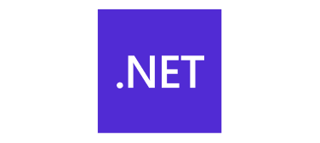










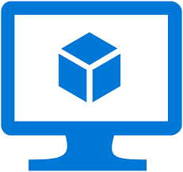



Azure Application Development
Develop on your favorite languages add text
and more...text
Using your favorite tools
and more...text
Deploy to managed services (or even VMs...)

Slide 29
Azure Application development
Exams & Certifications
Microsoft Certified: Azure Developer Associate
Microsoft learn
ΑΖ-204 Microsoft Azure Developer
docs.microsoft.com
Microsoft Certified: Azure IoT Developer Specialty
AZ-220
Microsoft Azure IoT Developer
Microsoft Certified: DevOps Engineer Expert
ΑΖ-204 Microsoft Azure Developer
Or
AZ-104
Microsoft Azure Administrator
AZ-400
Designing and Implementing Microsoft DevOps Solutions
https://docs.microsoft.com/en-us/learn/certifications/

Slide 30
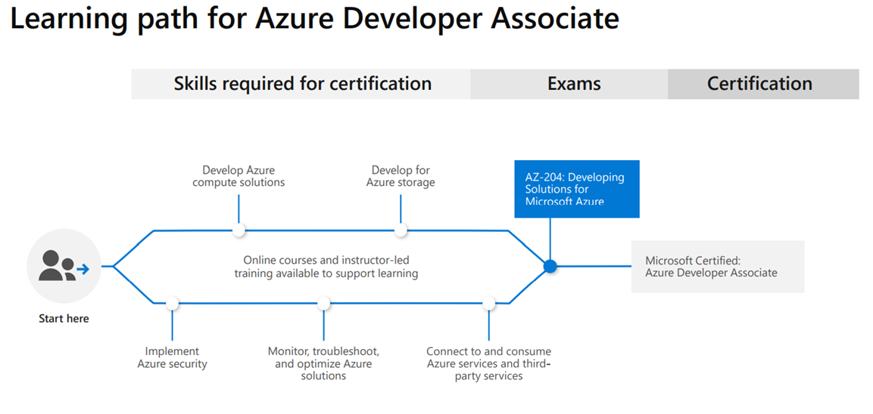
Azure Application development

Slide 31

Azure AI Making AI real for every person and every organization
Engage customers
Empower employees
Systems & Experiences
Intelligent
AI
Optimize operations
Transform products
George Armeniakos
Partner Technology Strategist
Microsoft GRCYMA
Transforming business with artificial intelligence

Slide 32










Easily turn data into intelligent action
Information Management
Big Data Stores
Machine Learning and Analytics
Intelligence
Data Sources
People
Data Factory
Data Lake Store
Machine Learning
Cognitive Services
Data Lake Analytics
Data Catalog
Synapse
Analytics
Bot Service
Web
Apps
HDInsight
Event Hubs
Cosmos DB
Cortana
Mobile
Stream Analytics
Apps
Azure IoT
SQL DB
Azure Databricks
Dashboards & Visualizations
Bots
Sensors and devices
Azure Analysis Services
Azure Data Share
Data Explorer
Azure Cognitive Search
Power BI
Automated Systems
Data
Intelligence
Action

Slide 33
Training & Certification Path
Azure Data Engineer
Azure Data Scientist
Azure Data Fundamentals (DP-900)
Azure Data Engineer (DP-200 + DP-201)
Azure Database Administrator (DP-300)
Azure Data Fundamentals (DP-900)
Azure Data Scientist (DP-100)
Azure AI Engineer
Data Analyst
Azure AI Fundamentals (AI-900)
Azure AI Engineer (AI-100)
Azure Data Fundamentals (DP-900)
Data Analyst (DA-100)
Azure IoT Developer
Azure Data Fundamentals (DP-900)
Azure IoT Developer (AZ-220)

Slide 34

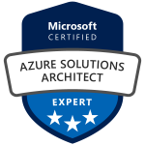
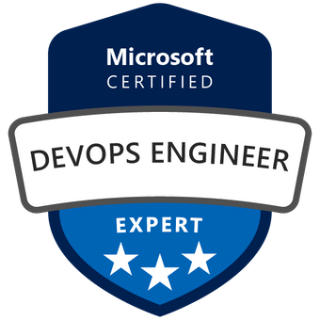
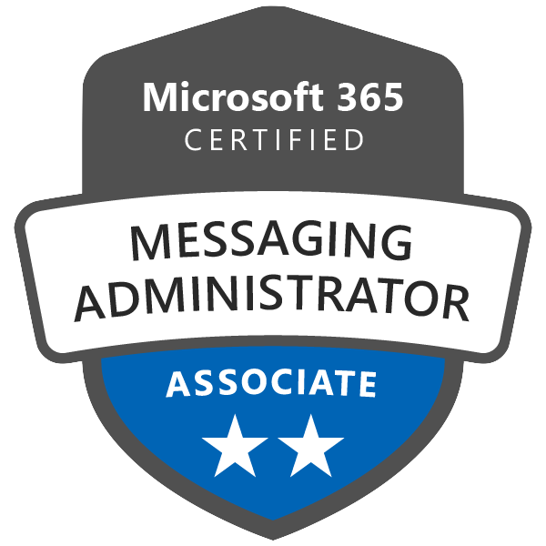
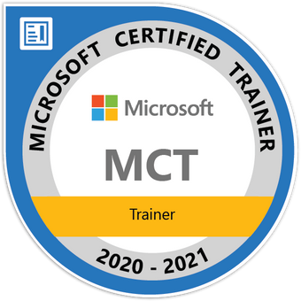
Azure devops (az-400)
A few bits about me
“
Automate, automate, automate!!!
https://flymetothecloud.com
/in/dpantaz
github.com/dpantaz
Dimitris Pantazis
IT Expert | Trainer | Blogger
Senior Engineer
@ UniSystems

Slide 35
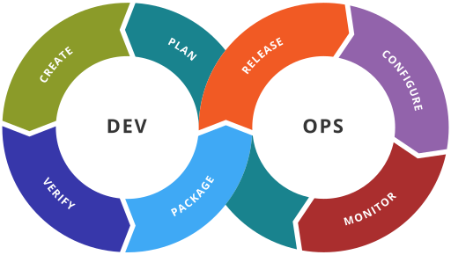
Azure devops (az-400)
DevOps is the union of people, process and tools that helps organizations deliver high quality software and services
Azure was built with DevOps in mind
Azure DevOps is a cloud-based service that provides:
Boards
Repos
Pipelines
Artifacts
Test plans
You can start with Azure DevOps for free (up to 5 users)
Plans available for large teams

Slide 36
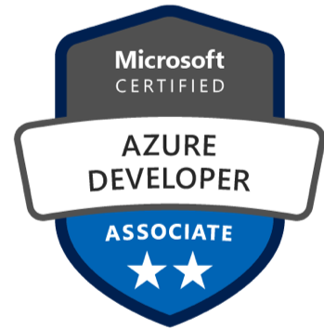
Azure devops (az-400)
Azure DevOps Engineer Expert
Develop an instrumentation strategy
Develop a Site Reliability Engineering (SRE) strategy
Develop a security and compliance plan
Manage source control
Facilitate communication and collaboration
Define and implement continuous integration
Define and implement a continuous delivery and release management strategy
ΑΖ-104
Azure Administrator Associate
OR
ΑΖ-204
Azure Developer Associate

Slide 37

Azure devops (az-400)
How to prepare
Microsoft Learn (https://docs.microsoft.com/en-us/learn/certifications/exams/az-400)
Pluralsight (https://www.pluralsight.com/partners/microsoft/azure)
Azure DevOps Labs (www.azuredevopslabs.com)
Microsoft Docs (https://docs.microsoft.com/en-us/azure/devops)
Sign up for Azure DevOps free tier (https://dev.azure.com)
Get access to an Azure Subscription
Corporate
Free trial

Slide 38

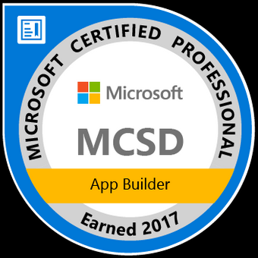
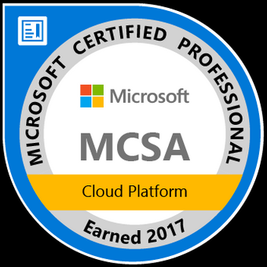
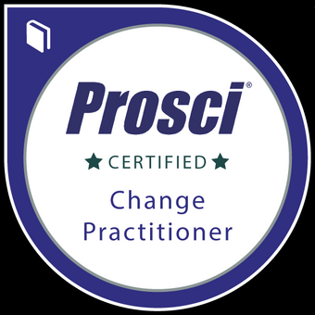
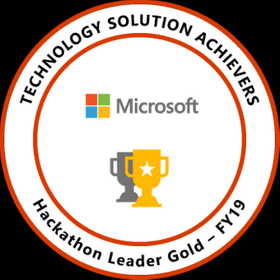
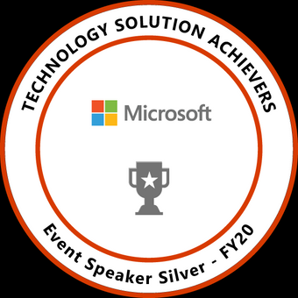
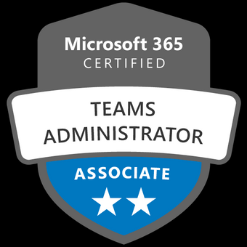
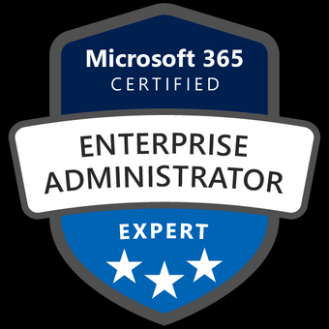

Microsoft 365
A few bits about me
“
Been working on Microsoft 365 and Azure since I joined Microsoft
Developer background – Microsoft Student Partner
Obsessed with MS Teams and its extensibility
Love advocating the Microsoft Modern Work Vision
Dedicated to helping partners build disruptive solutions
/in/sophiehn
github.com/sophiehn
sochania@microsoft.com
Sophie Chanialaki
Modern Work Partner
Technical Architect
@ Microsoft

Slide 39


Slide 40





For Home
For Small Business
For Enterprise
For Education
Find out more
Find out more
Find out more
Find out more

Slide 41







Microsoft Security & Compliance
A few bits about me
“
Love Cybersecurity discussions and challenges!
Helping Enterprises in our region to secure their identities, data, applications and
achieve their compliance requirements
in/michael-angelo-haggar
@BlueScreenX86
michagka@microsoft.com
Michael Haggar
Security and Compliance Technical Specialist
@ Microsoft

Slide 42
Microsoft 365 Defender
Automated cross-domain security
Identities
Endpoints
Cloud Apps
User Data
Microsoft Defender for Identity
Microsoft Defender for Endpoint
Microsoft Cloud App Security
Microsoft Defender for Office 365
Shift from individual silos to coordinated cross-domain security
Notes:
That’s why were introducing Microsoft 365 Defender. The next iteration of our Microsoft Threat Protection journey.
Automated cross domain security that out of the box combines the power of these products by merging their signals and capabilities into a single cross-domain solution.
end-to-end experience protecting the organization’s network.
----------------------------------------
leftovers
[Cori] We introduce new layers of cross-product knowledge and capabilities –
Signal sharing – e.g. Office ATP found a malicious payload in email, all other products now know to block this file wherever they see it
Unified entity reputation & semantics – all products contribute to building reputation about users, files, URLs etc. and share this, so e.g. If MDATP needs to make a decision about some suspect endpoint behavior, it is now able to consider the reputation of the user executing the activity across the stack
Automated coordinated protection & remediation playbooks – e.g. if MDATP identifies a malicious file on a machine and finds it was delivered via email, it can coordinate remediation with others so beyond the machine that’s remediated, similar emails can be zapped from other users’ mailboxes and relevant user accounts subjected to MFA…
Enable security teams to visualize, investigate, hunt and remediate attacks across protection areas in a single unified portal

Slide 43




Intelligent compliance and
risk management solutions
Information Protection & Governance
Insider
Risk Management
Discover & Respond
Compliance Management
Protect and govern data wherever it lives
Identify and take action on critical insider risks
Quickly investigate and respond with relevant data
Simplify compliance and reduce risk

Slide 44
Microsoft 365
Skill up – Learning & Certification for Microsoft 365
Job roles: Messaging Administrator, Modern Desktop Administrator, Teams Administrator, Enterprise Administrator
Microsoft learn
MS-900 Microsoft Fundamentals
Microsoft 365 Certified: Fundamentals
MS-700
Managing Microsoft Teams
Microsoft 365 Certified: Teams Administrator Associate
Microsoft 365 Certified: Enterprise Administrator Expert
MS-100
Microsoft 365 Identity and Services
docs.microsoft.com
MS-203
Microsoft 365 Messaging
Microsoft 365 Certified: Messaging Administrator Associate
MS-101
Microsoft 365 Mobility and Security
MS-500
Microsoft 365 Security Administration
Microsoft 365 Certified: Security Administrator Associate
MD-100 Windows 10
MD-101
Managing Modern Desktops
Microsoft 365 Certified:
Modern Desktop Associate
https://docs.microsoft.com/en-us/learn/certifications/

Slide 45
Microsoft 365
Skill up – Learning & Certification for Microsoft 365
Job roles: Developer
Microsoft learn
docs.microsoft.com
Microsoft 365 Certified: Developer Associate
MS-900 Microsoft Fundamentals
Microsoft 365 Certified: Fundamentals
MS-600 Building Applications and Solutions with Microsoft 365 Core Services
https://docs.microsoft.com/en-us/learn/certifications/

Slide 46
Thank you

